Slide 1
Garbage Collector
Presented By
SAI KIRAN BEKKANTI

Slide 2
Contents
01
IDisposable Interfaces
02
GC.SuppressFinalize() method
03
Finally block in try catch
04
Final Keyword
05
Using Block
06
07
Finalize method
Destructor in csharp

Slide 3
Idisposable Interface
The IDisposable interface is used in C# to provide a way for objects to release unmanaged resources such as file handles, database connections, and network connections.
It defines a single method called Dispose() that should be called when the object is no longer needed to perform the cleanup of unmanaged resources.
Inside the Dispose() method we can perform the resources clean-up and also call GC.SuppressFinalize(this) to mark our object as finalized.
The IDisposable interface in C# is used to provide a standard mechanism for releasing unmanaged resources, and it is important to implement it properly to avoid resource leaks and improve performance.

Slide 4
GC.SuppressFinalize
GC.SuppressFinalize is a method provided by the .NET framework that allows developers to indicate to the garbage collector that a specific object does not require finalization, even if it has a finalizer method define.
Finalization is the process of cleaning up an object's resources before it is removed from memory.
By calling the GC.SuppressFinalize method on an object, you are telling the garbage collector that the finalizer method should not be called when the object is collected, and it can be removed from the finalization queue.
This can help improve the performance of the garbage collector and the overall performance of the application.
By using GC.SuppressFinalize, developers can improve the performance of their applications by reducing the time spent on finalization and improving memory usage.

Slide 5
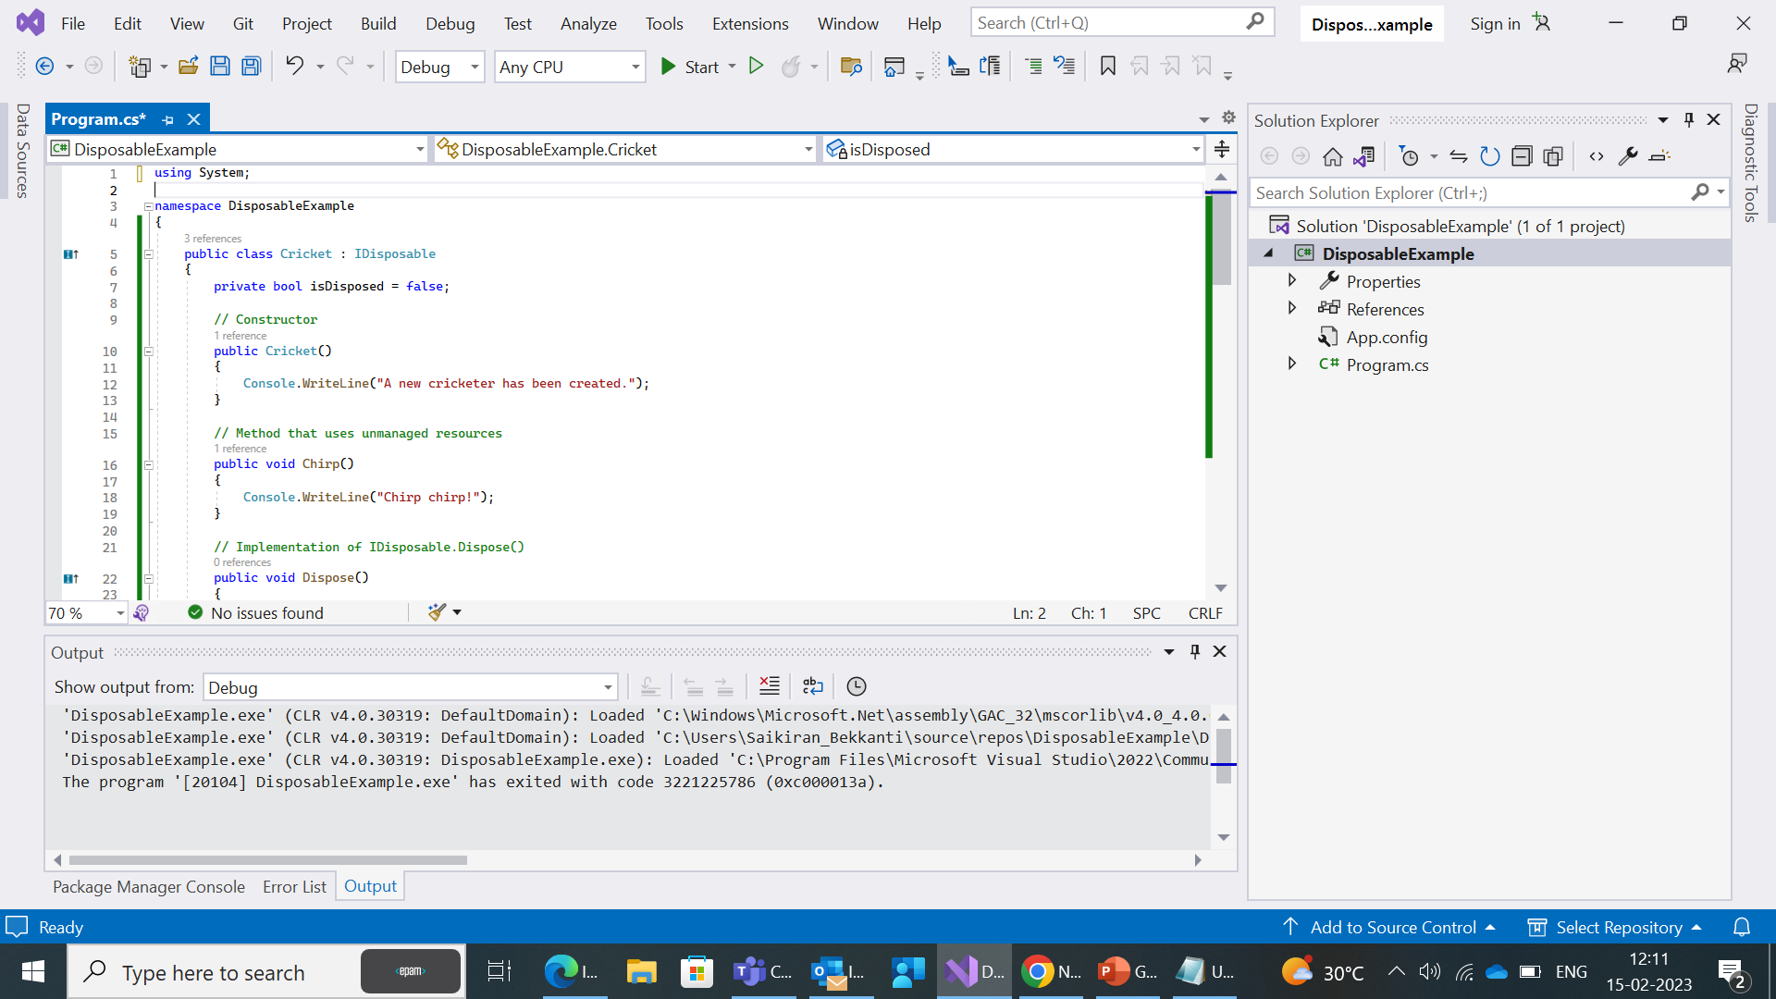
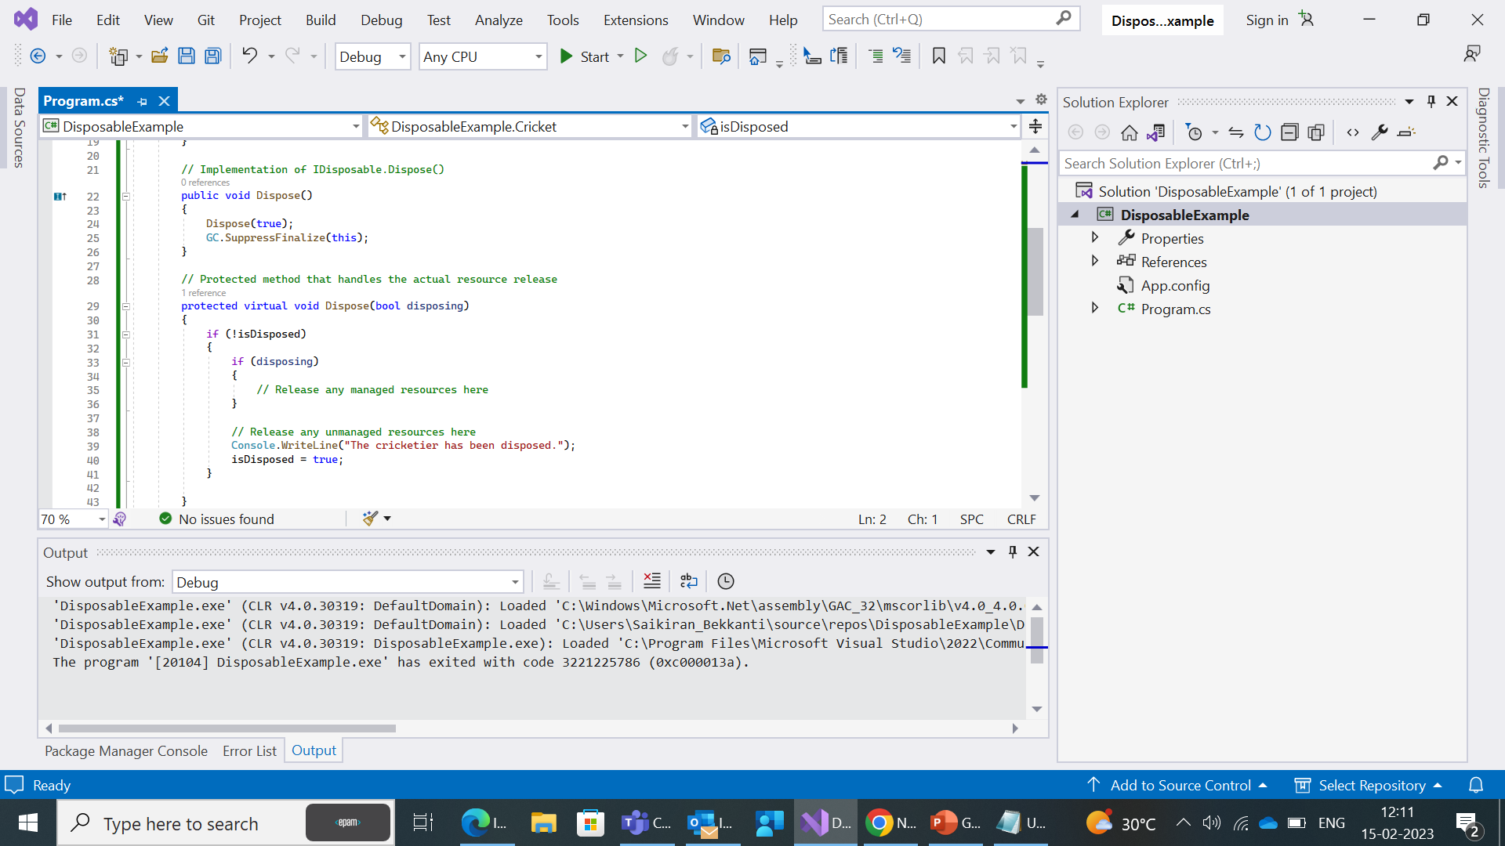

Slide 6
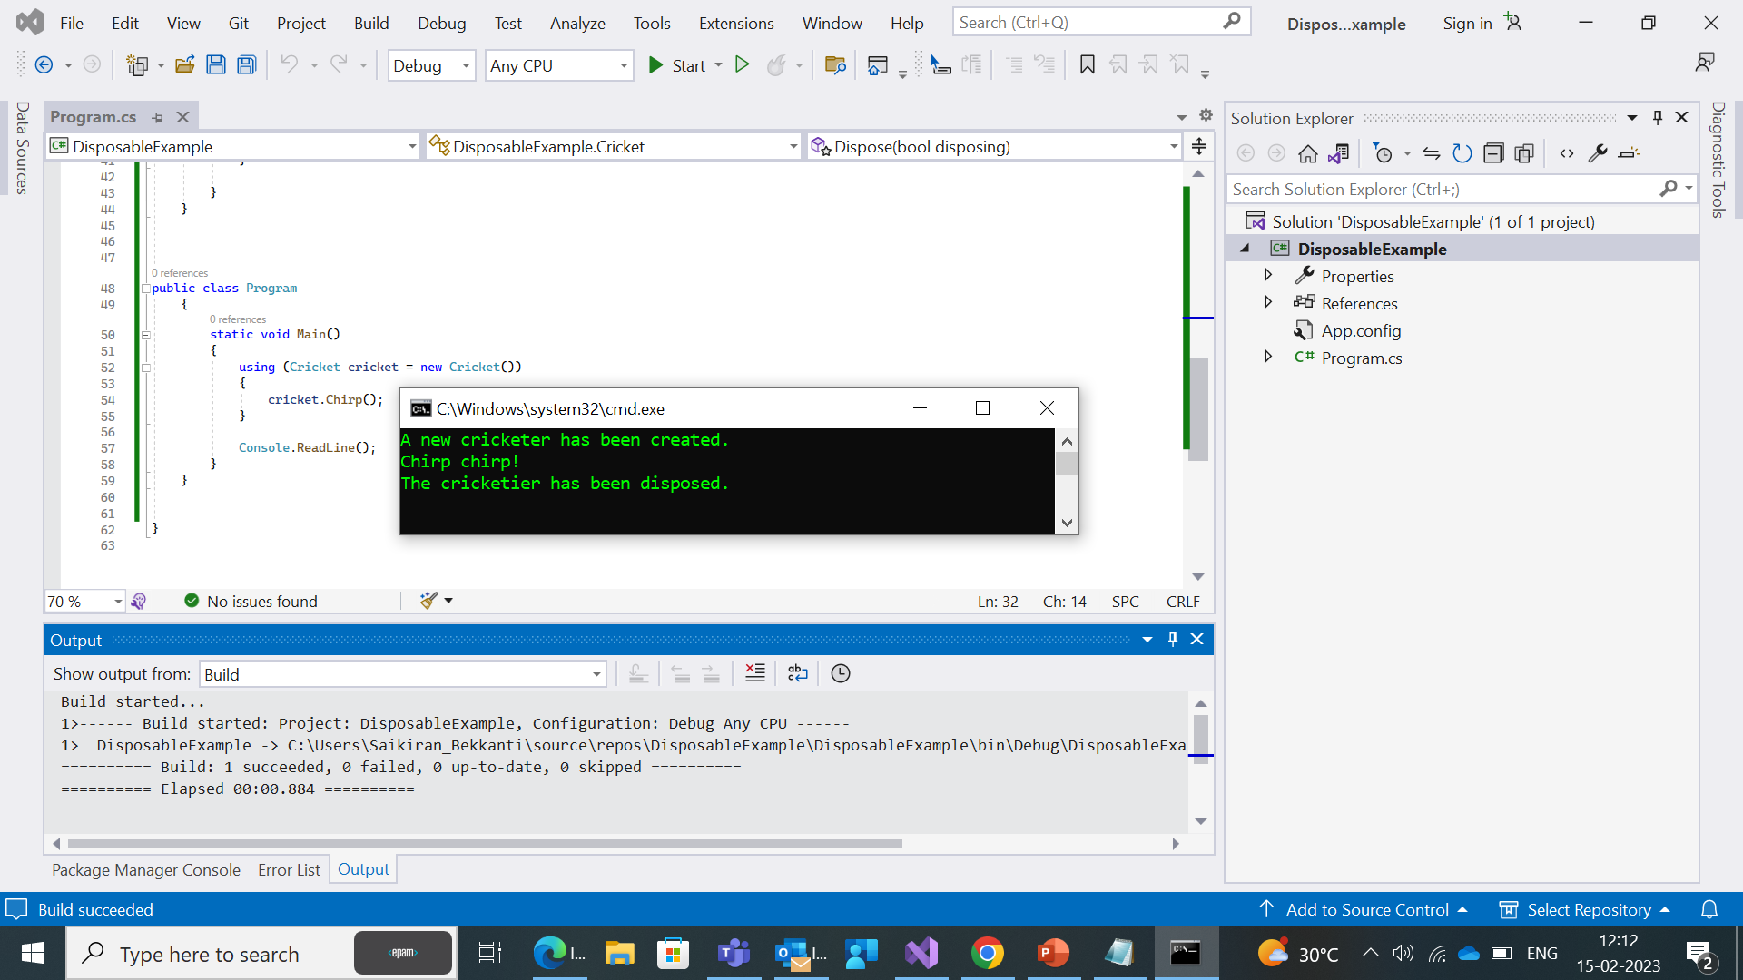

Slide 7
Final Keyword
In C#, the final keyword is used to indicate that a class, method, or property cannot be inherited or overridden by any derived classes.
When applied to a class, the final keyword indicates that the class cannot be subclassed. In other words, it cannot be used as a base class for any other class.
When applied to a method or property, the final keyword indicates that the method or property cannot be overridden in any derived classes.
This means that the behavior defined in the base class will remain the same in all derived classes.
We Use the sealed or readonly keyword in C# for the same implementation.

Slide 8
Finally
In C#, the finally block is a part of a try/catch block structure that is used to guarantee that a section of code is executed, regardless of whether an exception is thrown or not.
The finally block contains code that is executed after the try block has completed, and after any catch blocks have executed.
try {
// some code that may throw an exception
}
catch (Exception ex) {
// handle the exception
}
finally {
// cleanup code that will be executed regardless of whether an exception was thrown
}

Slide 9
Using Block
In C#, the using block is used to ensure that an object is properly disposed of when it is no longer needed.
The using block is typically used with objects that implement the IDisposable interface, which provides a way for objects to release unmanaged resources such as file handles, database connections, and network connections.
The using block ensures that the Dispose method of the object is called when the block is exited, even if an exception is thrown.
This helps to ensure that resources are properly cleaned up and released, and can help to prevent memory leaks.

Slide 10
Finalize
The Finalize method in C# is a special method that is called by the garbage collector before an object is removed from memory.
The purpose of the Finalize method is to allow the object to perform any necessary cleanup or release any resources before it is destroyed.
The Finalize method is automatically called by the garbage collector, and you do not need to explicitly call it.
It is called on a separate thread, so it is important to ensure that the method is thread-safe and does not access any objects that have already been collected.

Slide 11
Destructor
In C#, a destructor is a special method that is used to clean up unmanaged resources when an object is destroyed. Destructors are sometimes referred to as "finalizers".
Destructors are defined in a class using the ~ClassName() syntax, where ClassName is the name of the class.
A destructor does not take any parameters or return any values, and its access level must be public.
The destructor is automatically called by the garbage collector before the object is destroyed.
It's important to note that destructors should only be used when working with unmanaged resources that cannot be cleaned up using the Dispose method.
In general, it's better to use the IDisposable interface and the Dispose method to manage resource cleanup in a more deterministic and timely manner.

Slide 12
Difference between Idisposable Interface and destructors
Usage:
Destructors are used to clean up unmanaged resources when an object is being garbage collected, while the IDisposable interface is used to clean up resources explicitly.
Timing:
Destructors are called by the garbage collector when the object is being finalized, while the Dispose() method of the IDisposable interface is called explicitly by the developer when the object is no longer needed.
Control:
Destructors cannot be called explicitly by the developer, so the control over the cleanup process is entirely in the hands of the garbage collector. In contrast, the Dispose() method of the IDisposable interface can be called explicitly by the developer, giving them greater control over the cleanup process.

Slide 13
Type safety:
The IDisposable interface provides type safety, allowing the developer to use the using statement to ensure that the Dispose() method is called automatically when the object is no longer needed. Destructors do not provide this level of type safety.
Scope:
Destructors are defined as part of the object's class definition, while the IDisposable interface is defined separately and can be implemented by any class that needs to clean up resources.

Slide 14



Slide 15
